Slide 1
Machine Learning in Medical Imaging
Project Presentation
Claus Meschede, Leonard Rychly
18. July 2016
U-Net: Convolutional Networks for Biomedical Image Segmentation

Slide 2
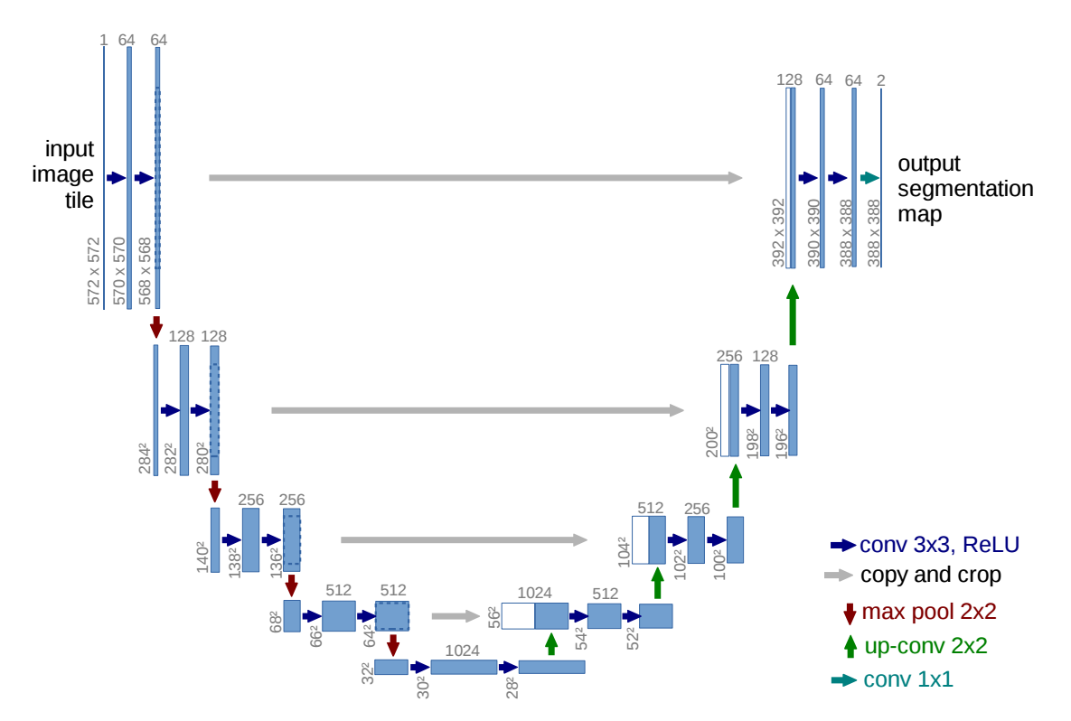
Architecture

Slide 3
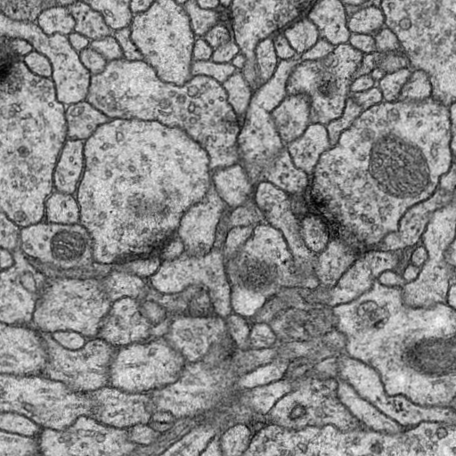
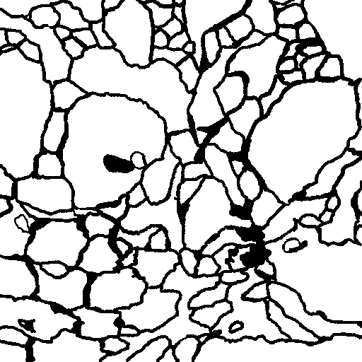
Original Task

Slide 4
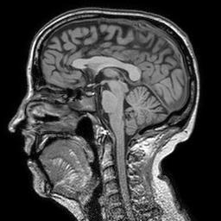
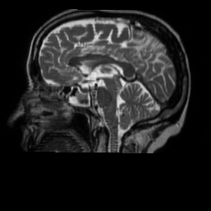
Our Task

Slide 5
Different approaches building the U-Net
Starting with a small version of the U-Net
Leaving out the “Crop and Copy”-Layers
Replacing Transposed Convolution with a Unpooling Layer
Varying number of input images

Slide 6
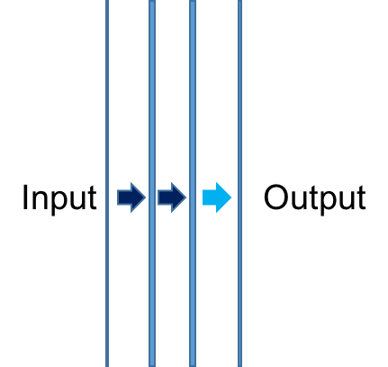
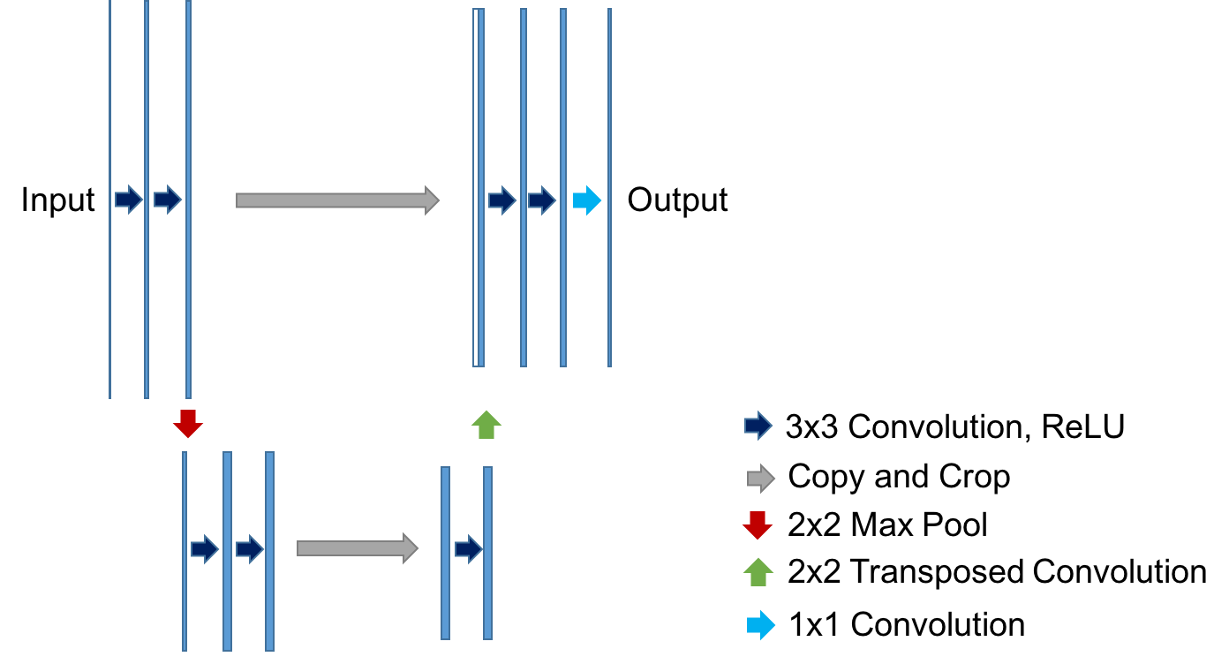
Small U-Net

Slide 7
Small U-Net Results

Slide 8
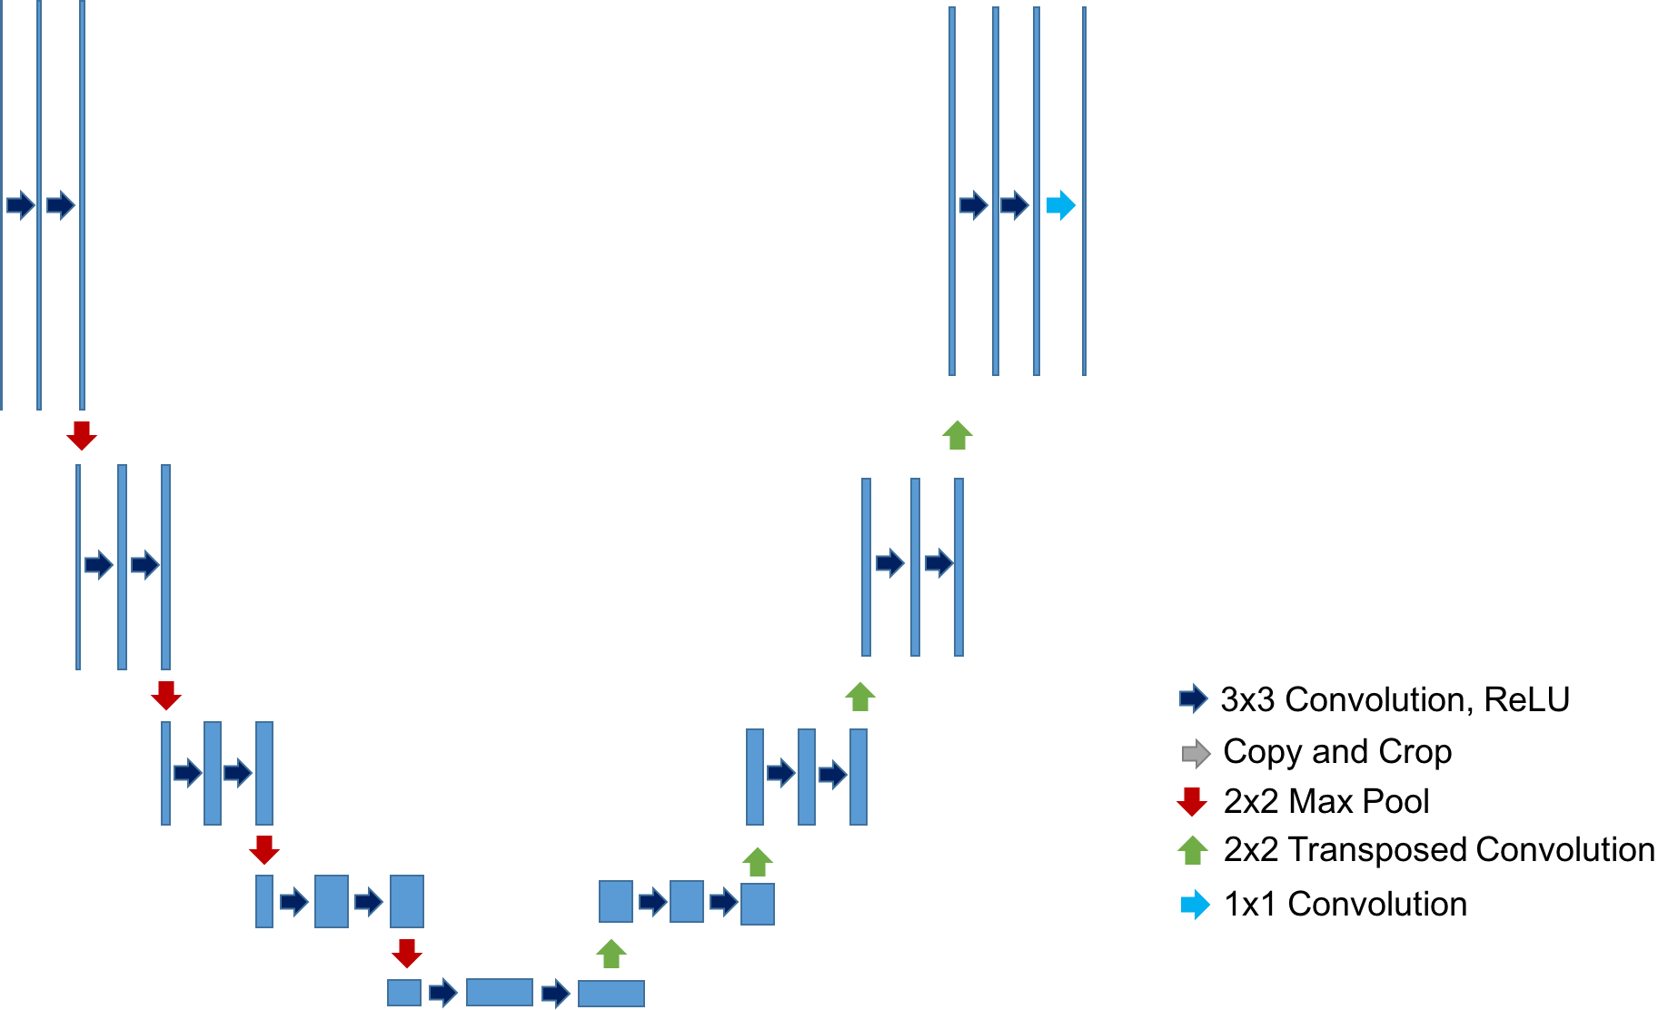
Leaving out the “Crop and Copy”-Layers
Input
Output

Slide 9
Leaving out the “Crop and Copy”-Layers Results

Slide 10
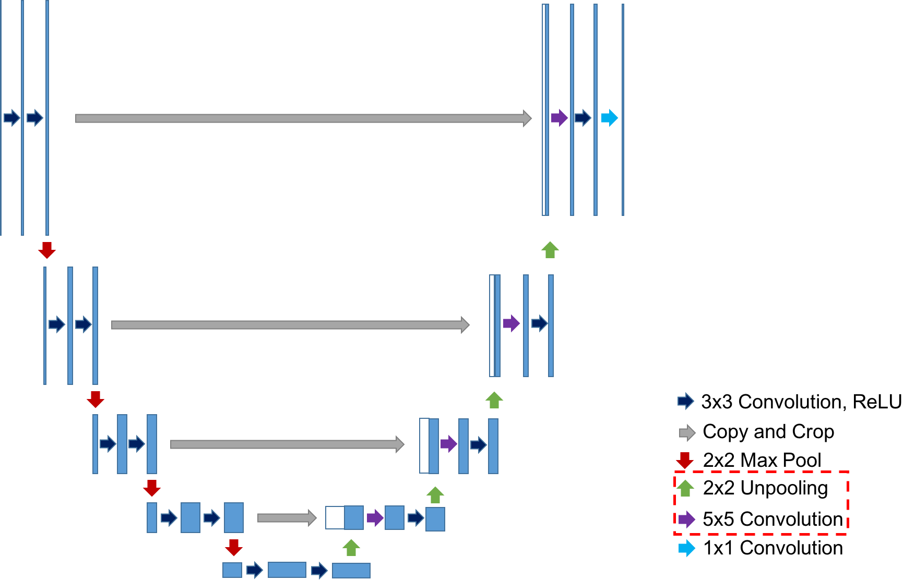
Replacing Transposed Convolution with Unpooling Layer
Input
Output

Slide 11
Replacing Transposed Convolution with Unpooling Layer Results

